Slide 1
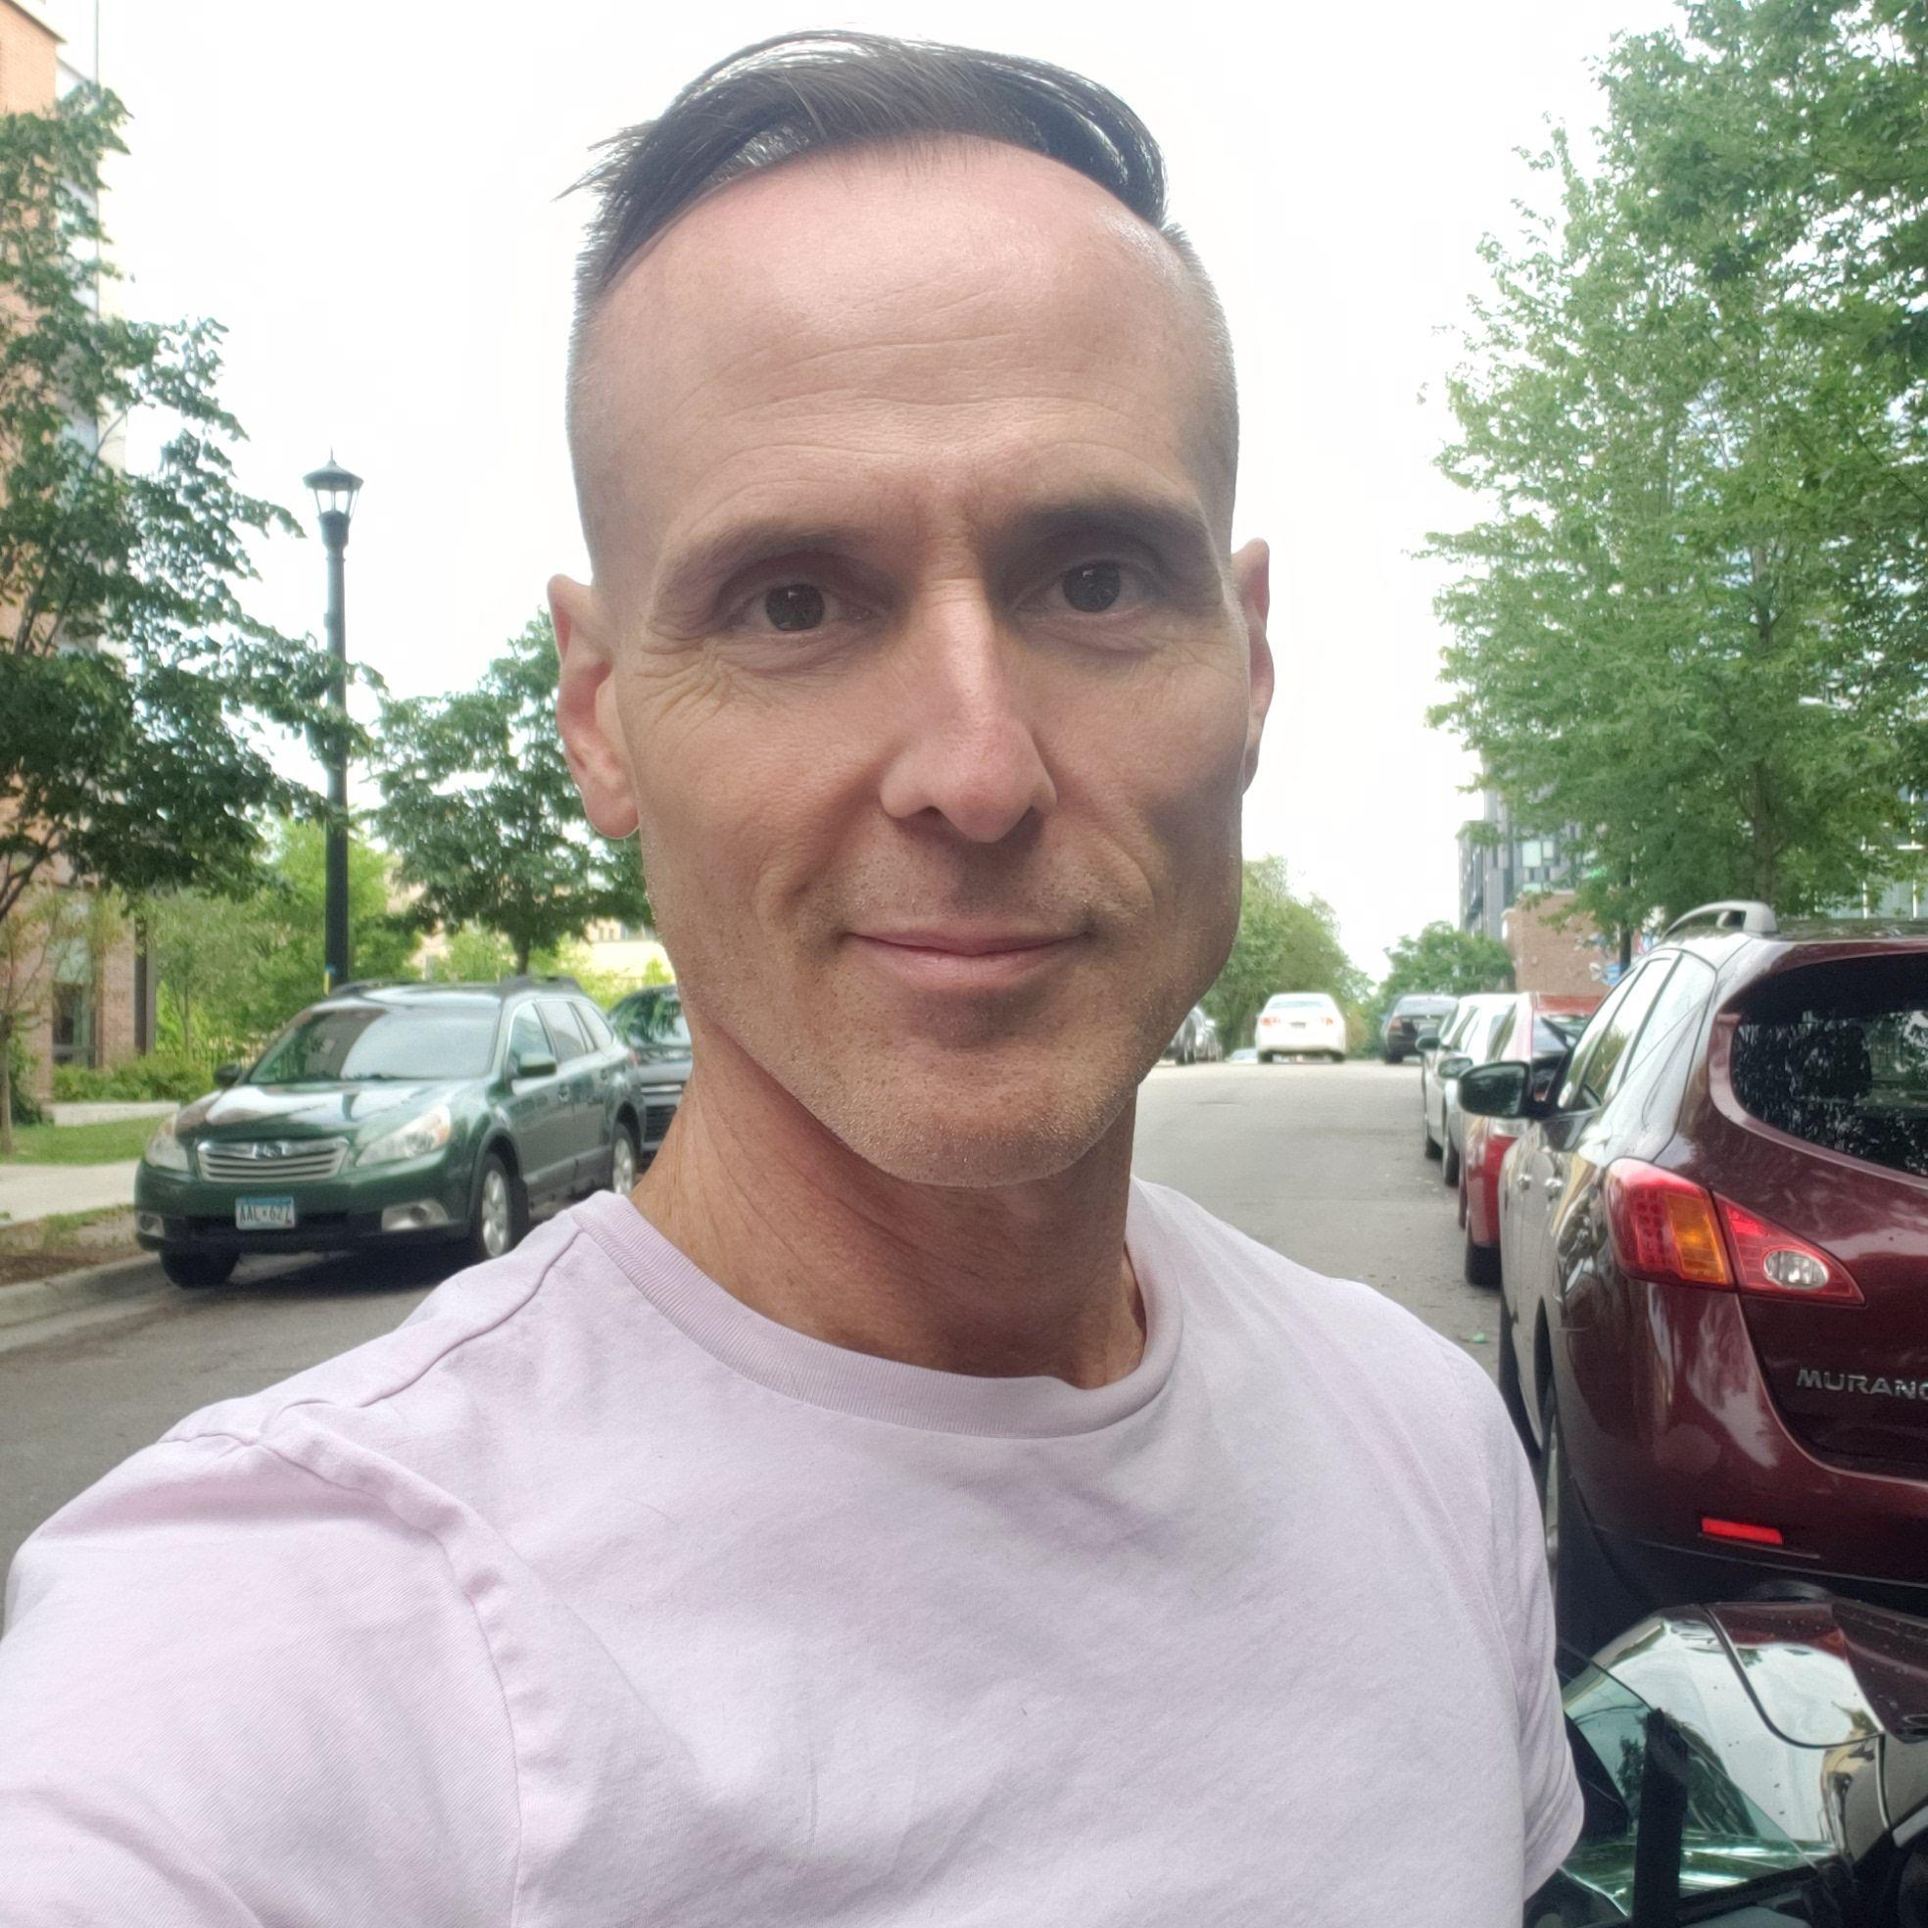
Vendor Information \ Load-in
August 31, 2023
Pride Event - September 10,2023 12 - 5 PM
Derrick Strom (He/Him)
Event Vendor Manager derrick.strom@tcpride.org

Slide 2
Agenda
ST-19 & COI Examples
Vendor Map & Booth Location
Vendor Information
Safety Briefing
Location, Setup Hours & Festival Hours
Food Setup
Booth Setup
Load-out
Q&A

Slide 3
ST-19 Tax Form
Business Name and Address
Tax ID number if required
Name, Location and Dates of Event
Bloomington Pride
Bloomington Civic Plaza
September 10, 2023
Tax Exemption Information Section if Tax ID is not required
All vendors even if not selling
Signature
THIS IS CORRECT:

Slide 4
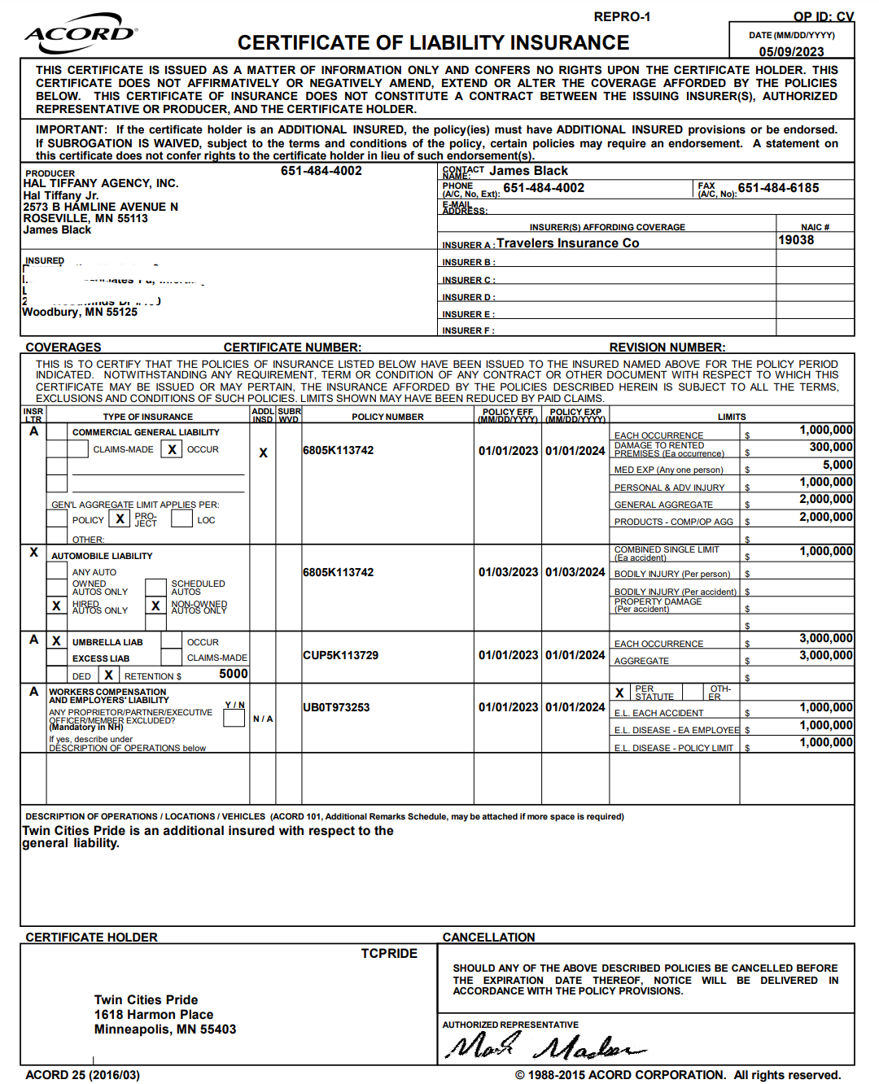
Proof of Insurance (COI)
This is what a CORRECT COI looks like:
Being Self Insured is also Acceptable on Company/State Letterhead.

Slide 5
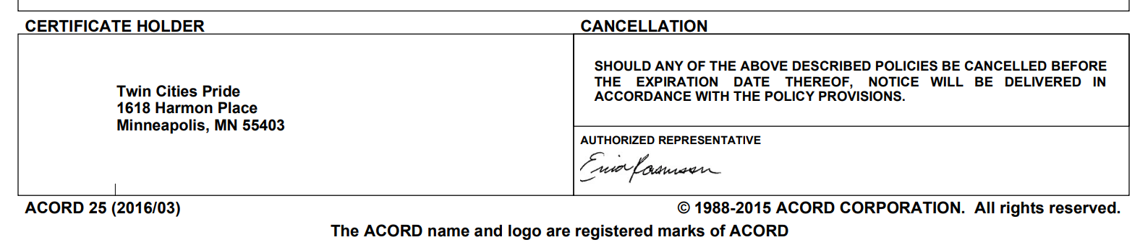
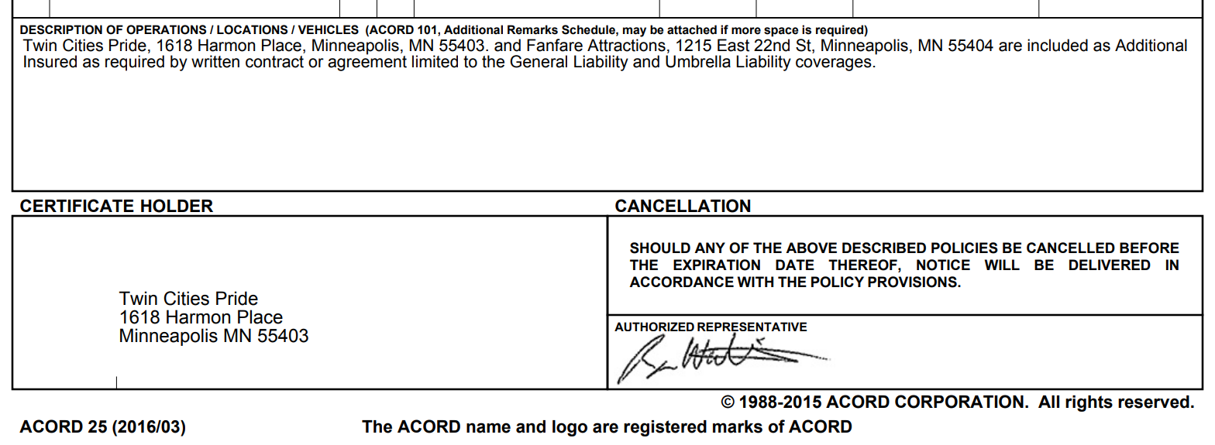
Proof of Insurance (COI)
Must be a Certificate of Liability Insurance.
Must have a current date (not expired)
Date within 1 year of the Festival dates
Must List Twin Cities Pride as additional insured (with address).
.
THESE ARE CORRECT:
Notes:
If one is listed we need a document for each
If both are listed 1 document is ok

Slide 6
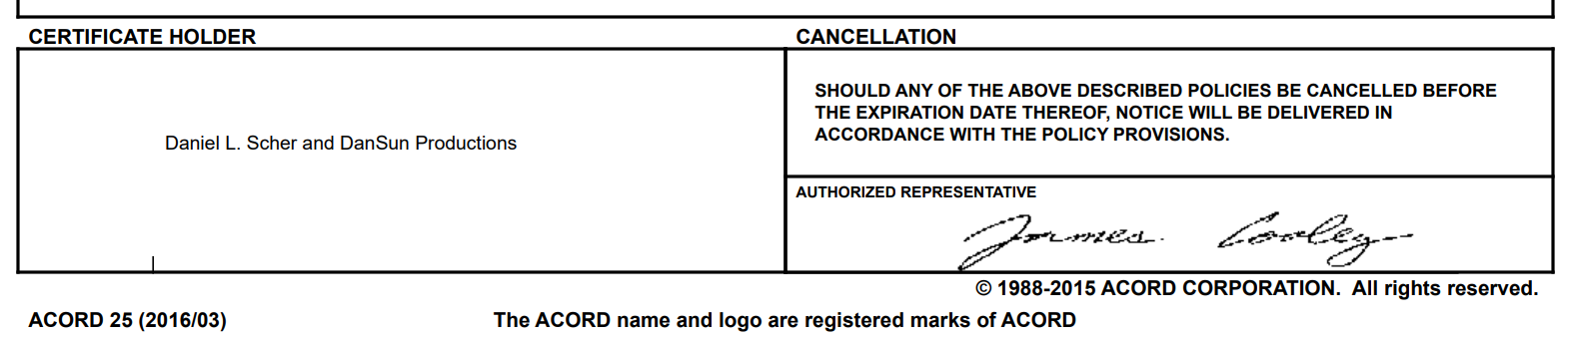
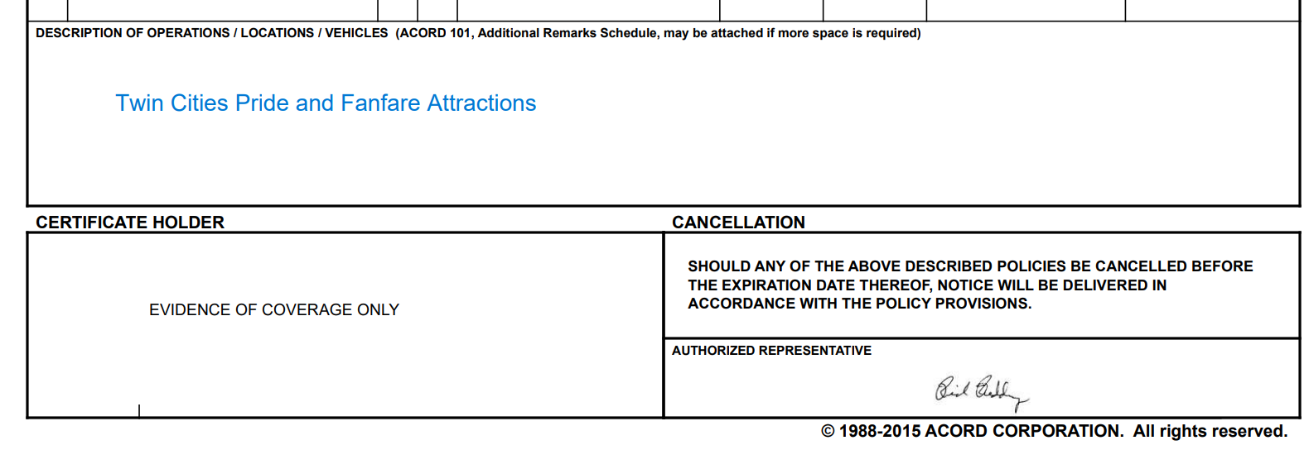
Proof of Insurance (COI)
These are NOT VALID
DATE OLDER THAN 1 YEAR
Certificate Holder is Blank or list some other Organization or names than Twin Cities Pride.
Does not list address or state we are additional insured or as Certificate Holder
THESE ARE INCORRECT:

Slide 7
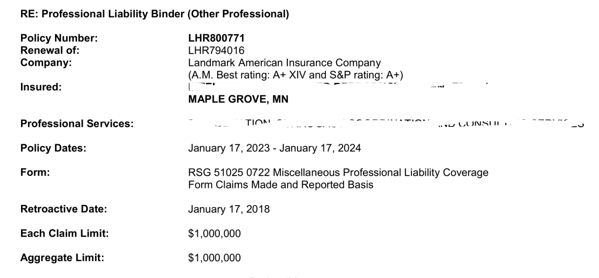
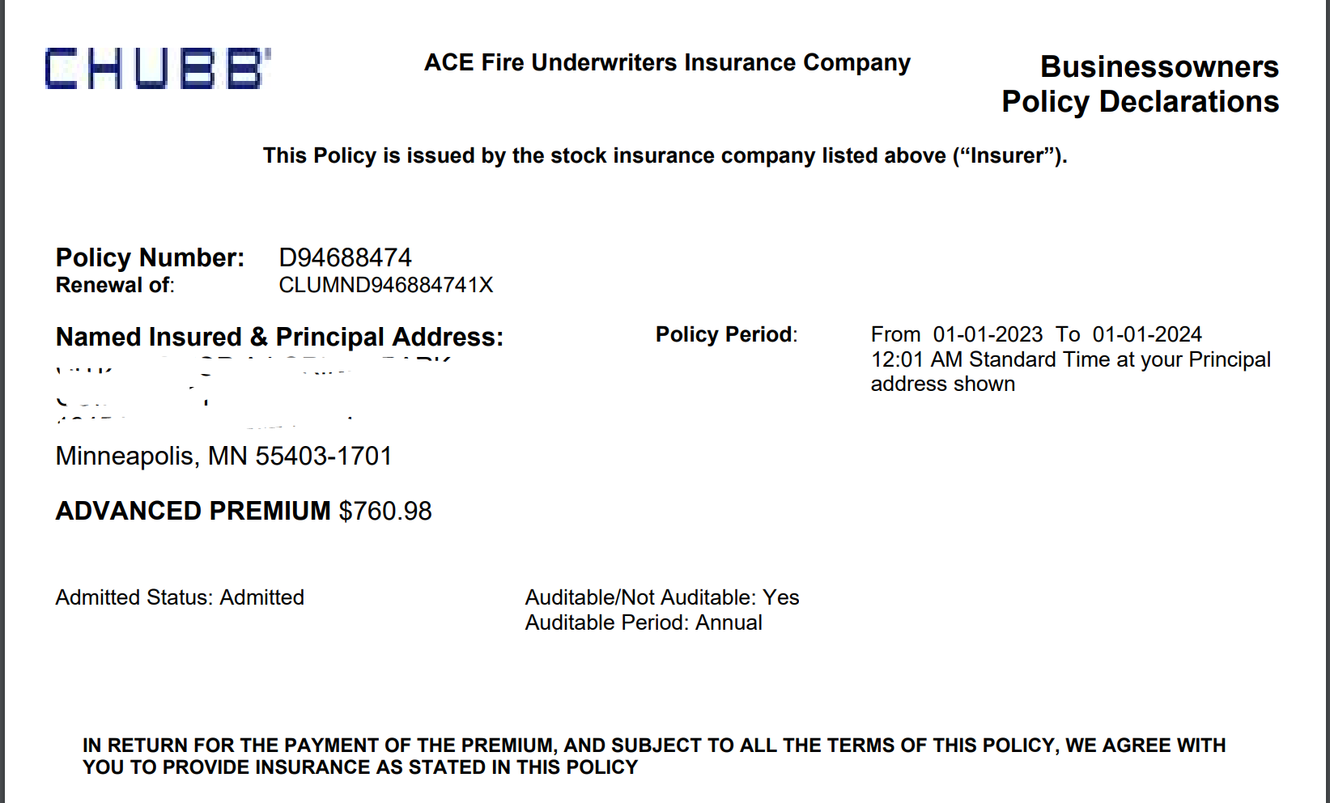
Proof of Insurance (COI)
These are not Valid
Copy of your Policy of Insurance Binder
THESE ARE INCORRECT:

Slide 8
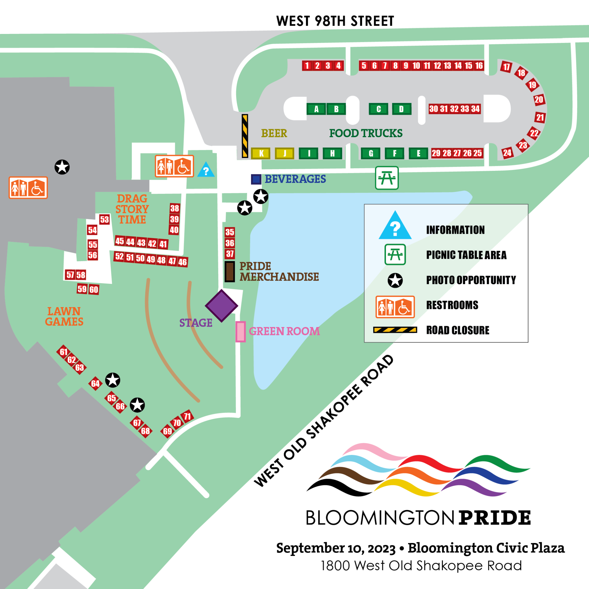
Festival Map & Booth Locations
https://bloomingtonpridemn.org/festival-map/
FIND YOUR BOOTH NUMBER WITH INTERACTIVE MAP
Email to applicant with map / list
Most Current Map and Information
PDF Version
Interactive MAP with links to vendors
https://www.eventeny.com/events/map/?id=6357&mid=4952

Slide 9
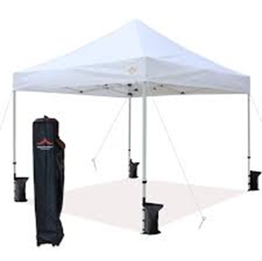
ALL VENDORS - Setup Information
Subtitle placeholder
TENTS MUST BE WEIGHTED
No stakes
40lbs per tent leg 10x10 - Sand, water, weights
Confirm your spot - Location is Marked on Ground
Wrong tent location – you will be asked to move
NO VEHICLES ALLOWED IN Grass / Sidewalks for Load-In

Slide 10
TRASH MANAGEMENT
Haul your trash to DUMPSTERS
Flatten cardboard
DO NOT fill cardboard boxes with trash.
Watch weight in bags DO NOT OVERLOAD - humans are hauling.
NO GREASE left or in garbage we cannot take it.

Slide 11
Festival Safety Briefing
Safety Protocols – YOUR PART
Be Kind and Helpful
Report
Violence, threats, or hate.
Unattended bags, suspicious activity.
Drones.
Attendance
Don't attend/travel alone.
Write down emergency contacts & let them know.
Meet-up spot.
Self-Care
Stay hydrated!
Wear sunscreen, find shade, and take breaks from the sun.
Wear comfortable closed-toe shoes.
Know your limits.

Slide 12
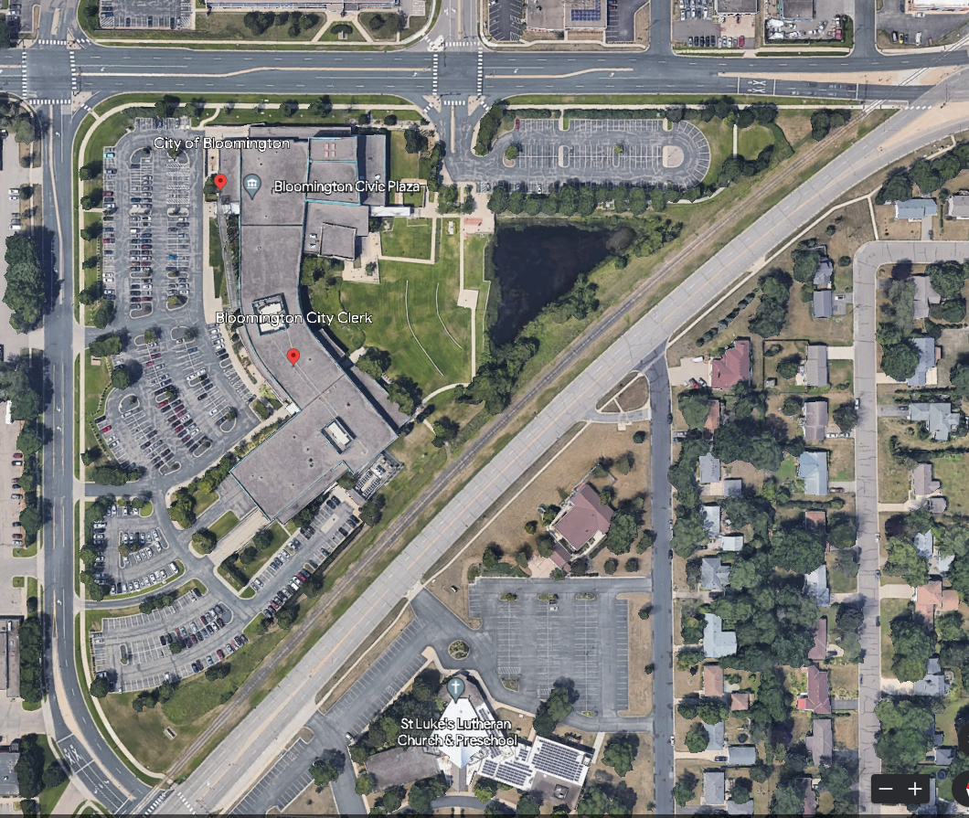
Locations & Times
Logan Ave
PARKING
September 10th - Bloomington Civic Plaza
1800 West Old Shakopee Road
Setup Food Vendors 8AM - 9:30AM
Setup Booth Vendors 9:30AM - 11AM
Booths 1- 34
Booths 35 - 71
Festival Hours 12 - 5 PM

Slide 13
Check-in
Check-in at the Information Booth
Unload & Check-in → Setup
https://www.eventeny.com/events/map/?id=6357&mid=4952

Slide 14
FOOD SETUP
Green Booths: A - I
ALL Food Vendors
Setup - September 10th
Food Vendors 8AM - 9:30AM
Drive in and be placed
Additional Parking in Logan Lot
HARD CLOSE at 11 AM
Maps available at
https://bloomingtonpridemn.org/festival-map/
Notes:
ROUTE 1A + 1B ENTRY AND QUEUE Take Lasalle Ave to Oak Grove Street, head westbound, go to West 15th Street, turn left onto Oak Grove Street/West 15th and line up in the metered spaces to enter Loring Park on the right with Entry Pass before you get to Hennepin. Booth Vendors enter at 1A, Food Vendors enter at 1B.
DO NOT attempt to enter Loring park by turning off of Hennepin Avenue onto Oak Grove and cutting in front of traffic to turn into the Park.

Slide 15
Booth 1 - 34 SETUP
Red Booths: 1 - 34
Exhibitor Vendors & Sponsors
Unload to Booth Space
Setup - September 10th
Booth Vendors 9:30 AM - 11 AM
Cart in and out RECOMMENDED
NO PARKING in 98th Street Lot
Unload Vehicle under escort in lot
5 minute unload
proceed to parking area
HARD CLOSE at 11 AM
Maps available at
https://bloomingtonpridemn.org/festival-map/
Notes:
ROUTE 1A + 1B ENTRY AND QUEUE Take Lasalle Ave to Oak Grove Street, head westbound, go to West 15th Street, turn left onto Oak Grove Street/West 15th and line up in the metered spaces to enter Loring Park on the right with Entry Pass before you get to Hennepin. Booth Vendors enter at 1A, Food Vendors enter at 1B.
DO NOT attempt to enter Loring park by turning off of Hennepin Avenue onto Oak Grove and cutting in front of traffic to turn into the Park.

Slide 16
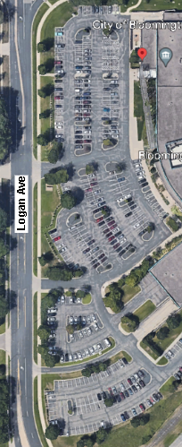
Booth 35 - 71 SETUP
Red Booths: 35 - 71
Exhibitor Vendors & Sponsors
Unload to Sidewalk
Cart to Booth
Setup - September 10th
Booth Vendors 9:30 AM - 11 AM
Cart in and out REQUIRED
Recommended from Logan Parking
optional unload to Sidewalk
5 minute unload
proceed to parking area
HARD CLOSE at 11 AM
Maps available at
https://bloomingtonpridemn.org/festival-map/
Notes:
ROUTE 1A + 1B ENTRY AND QUEUE Take Lasalle Ave to Oak Grove Street, head westbound, go to West 15th Street, turn left onto Oak Grove Street/West 15th and line up in the metered spaces to enter Loring Park on the right with Entry Pass before you get to Hennepin. Booth Vendors enter at 1A, Food Vendors enter at 1B.
DO NOT attempt to enter Loring park by turning off of Hennepin Avenue onto Oak Grove and cutting in front of traffic to turn into the Park.

Slide 17
Load-Out - - - September 10
RECOMMEND CART OUT TO PARKING LOT IF POSSIBLE
5:00 PM Festival Ends
Clear Crowds
5:30 PM Cars Into 98th Street Lot
6:00 PM Barricade Down Food Trucks to Leave
6:30 PM Enter / Exit Parking Area
Notes:
Load Out Routes
7-8 vendors enter
Direction of traffic change at 8 pm – for food vendors to leave Route 1 & 2
Food vendors not out until 8 pm

Slide 18
Q & A
this deck, maps, and recordings of sessions available at
https://bloomingtonpridemn.org/festival-map/
Questions:
festival@bloomingtonpridemn.org

Slide 19
Thank You
Please send feedback to festival@bloomingtonpridemn.org

Slide 20
Logan Ave

